Slide 1


The Technology Value Stream
CSD-380
Katie Hilliard
05/29/2025

Slide 2

Contents
What is Technology Value Stream?
Lead Time
Processing Time
Lead vs. Processing Time (visual)
Deployment Lead Times Requiring Months
Deployment Lead Times of Minutes
References

Slide 3
What is Technology Value Stream?
The technology value stream is a process that consists of a sequence of events that are used to improve how development teams deliver the best quality for customers.
The two main focuses of the value stream is to be prompt with delivery for any requested features/updates from the customer and to ensure the efficiency of delivery is noticed by the customer.
Our text defines technology value stream as the required process to convert a business hypothesis into a technology-enabled service that delivers value to the customer. (Kim, Humble, Debois, Willis, & Forsgren, 2021)

Slide 4
Lead Time
Lead Time is the total time used for a product to make it through the value stream. This means from beginning (initial order) to end (product delivery). It is used to measure performance in the value streams. This time is mainly what the customer experiences.
Components of Lead Time:
Processing time (time that it takes to perform work on product/service
Inspection Time (examine the product, ensure quality standards are met)
Move Time (duration of moving products through the processes)
Queue Time (waiting time between each process)

Slide 5
Lead Time (continued)
Factors that impact Lead Time:
Efficiency of production processes
Material availability
Workforce efficiency
Machine uptime
Supply chain management efficiency
Ways to reduce Lead Time:
Just-in-time production: align production with customer demand (reduce inventory & eliminate waste)
Lean manufacturing: Continuous improvement and eliminating waste helps streamline processes
Process improvement: Review and optimize processes regularly to find bottlenecks
Technological advancements: use advanced technologies (AI) to help speed up processes

Slide 6

Processing Time
Processing time actually takes place during Lead Time, just after the initial ticket is created. The time between when the actual work begins and the product is delivered is considered Processing time. This portion of value streaming is the developers’ main focus. During this time, it is critical to achieve fast flow with short lead times to reduce the amount of time the work has to wait in the queue. (Kim, Humble, Debois, Willis, & Forsgren, 2021)

Slide 7
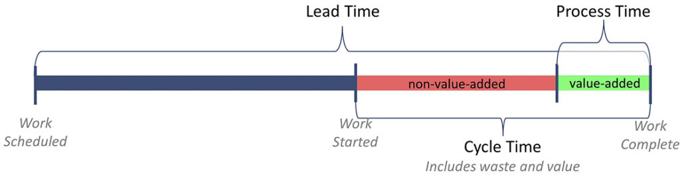
Lead vs. Processing Time
This visual example breaks down what takes place during Lead vs Processing Time.

Slide 8
Deployment Lead Times of Requiring Months
Sometimes deployment lead times may require months. This is more common among larger organizations that may have systems that are monolithic or tightly coupled. When this scenario occurs, it results in having longer test times and production lead times because they’re relying on manual test methods and several approval processes.
Longer deployment lead times means developers can expect issues during each stage of the value stream. There may be instances where nothing is functional within the project once all the changes have been made throughout the team. This means everything must be resolved prior to delivery which can prolong the project, exceed the budget, and have a negative impact on customer experience.

Slide 9
Deployment Lead Times of Minutes
There are also times when developers receive feedback from customers quickly and consistently. Issues can be resolved quickly, and developers can implement, update, and validate their code.
Here are a few ways to achieve this:
Check small code changes
Perform automated/exploratory testing
These methods can help boost developer confidence in their code before it’s deployed because they know that all errors have been detected and resolved to provide a seamless performance. This is a great opportunity to mitigate issues that could exist later or become larger issues if not reported quickly or detected early enough.

Slide 10
References
Kim, G., Humble, J., Debois, P., Willis, J., & Forsgren, N. (2021). The DevOps handbook: How to create world-class agility, reliability, & security in technology organizations (2nd ed.). IT Revolution.
Atlassian. (n.d.). What is value stream management? Retrieved May 29, 2025, from https://www.atlassian.com/agile/value-stream-management
Miro. (n.d.). What is lead time in value stream mapping? Retrieved May 29, 2025, from https://miro.com/value-stream-mapping/what-is-lead-time/

